Slide 1
Introduction to Data Science 3

Slide 2
Overview
Cross-validation
From classification to regression (and back)
Model complexity
Underfitting and overfitting
Cross-validation

Slide 3
Evaluation:
how well does it estimate the class labels of the dots?
Feature 2
Feature 1

Slide 4
Evaluation on Training Set
Determines how well a classifier can reproduce what it has seen before.
In case of the 1-NN classifier, reproduction is perfect (100%) if it has a feature that uniquely points to an instance and its label. (e.g., passenger-id in Titanic.arff)
We are NOT interested in reproduction!

Slide 5
Skills Class 2
Evaluation (“testing”) on test set

Slide 6
Evaluation:
how well does it estimate the class labels of the
GRAY (unlabeled) dots?
Feature 2
Feature 1

Slide 7
Evaluation on Test Set
Determines how well a classifier can predict the labels of previously unseen instances on the basis of what it has seen before (in the training set).
We ARE interested in prediction!

Slide 8
Selection bias
The selection of the test set (e.g., 10% of dataset) can affect the test results (positively or negatively) depending on the representativeness of the instances in the test set of the entire data set.
How to remove this selection bias?
Cross validation

Slide 9
3-fold Cross Validation
General case: k-fold Cross Validation. When k=N: Leaving-One-Out Cross Validation.

Slide 10
WEKA

Slide 11
From classification to regression

Slide 12

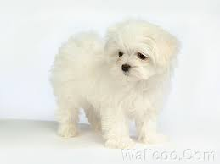
Correlation
Popov
cuteness
furriness

Slide 13
Description versus Prediction
Correlation is describing the data
We want to predict data,
therefore we model the data

Slide 14
What is a model?
In machine learning, a model takes the feature(s) as input and generates as output a label estimate
Input: furriness
Output: estimate of cuteness
Evaluation of the model: difference between estimates and true cuteness values

Slide 15
What is a suitable model?
a line!
cuteness
furriness

Slide 16
What is the best line?
cuteness
furriness

Slide 17
Answer: the best-fitting line
deviations from the model = error

Slide 18
The best-fitting line can be determined automatically

Slide 19
Regression Equation
CUTENESS = a FURRINESS + c
a is the slope of the FURRINESS line —> positive value
c is a constant

Slide 20
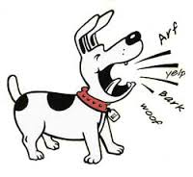
Adding a second feature..
cuteness
barkness

Slide 21
and a second model…
cuteness
barkness

Slide 22
Multivariate regression
cuteness
cuteness
furriness
barkness

Slide 23
Regression Equation
CUTENESS = a FURRINESS + b BARKNESS + c
a is the slope of the FURRINESS line —> positive value
b is the slope of the BARKNESS line —> negative value
c is a constant

Slide 24
Multivariate regression surface can be automatically determined
attractiveness
barkness
furriness

Slide 25
In WEKA…

Slide 26
How to measure the prediction power?
Linear regression is still model fitting, i.e., description rather than prediction
In other words: reproduction rather than prediction (and we are NOT interested in reproduction)

Slide 27
Prediction using Linear Regression
Fit the model to a subset of the data (training)
Test the predictions on the remaining data in a cross-validation procedure
TRAIN
TEST

Slide 28
WEKA
Linear Regression applied to Housing.arff…
www.cs.cmu.edu/afs/cs/academic/class/15381-s07/www/hw6/cal_housing.arff

Slide 29
label
weighted
features
Note the very large coefficients!
What is the cause?

Slide 30
Results of WEKA’s Linear Regression
applied to Housing regression task:
MAE
MSE
MAE: Mean of the absolute deviations
MSE: Mean of the squared deviations
deviations from the model = error
http://www.cs.cmu.edu/afs/cs/academic/class/15381-s07/www/hw6/cal_housing.arff

Slide 31
Model Complexity
in regression & classification

Slide 32
PLEASE NOTE!
Classification versus Regression (related to 2 types of scatterplots)
In classification, the model induced from the data defines a decision boundary that separates the data described by 2 features into 2 classes (e.g., cats versus dogs) or more.
In regression, the model induced from the data fits the data to describe the relation between 2 features or between a feature (e.g., furriness) and the label (e.g., cuteness)
NOT NOW
separates the data
fits the data

Slide 33
Regression

Slide 34
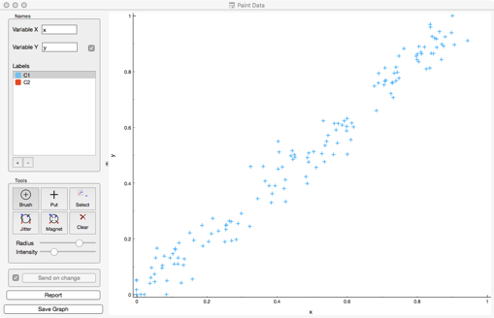
Case 1: Feature x, label y
What is the “best” model?

Slide 35
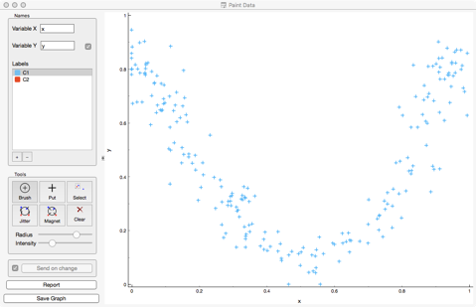
Case 2: Feature x, label y
What is the “best” model?

Slide 36
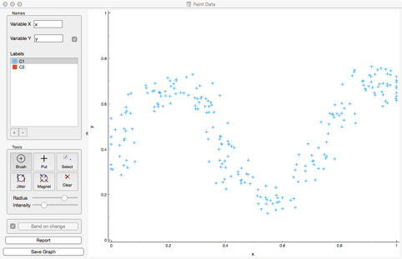
Case 3: Feature x, label y
What is the “best” model?

Slide 37
Model fitting
A polynomial is a curve that has a parameter that varies its complexity from 1 (linear=straight line) to a large number (very wiggly line)

Slide 38
Fitting a model to data
3 situations
Underfitting: model is too simple for the data
Overfitting:
model is too complex for the data
Best fit:
The simplest possible fitting model

Slide 39
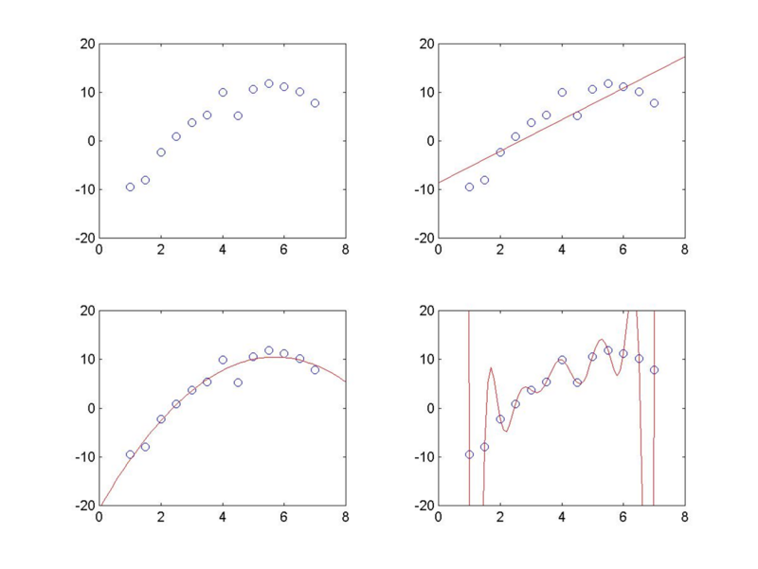
regression problem
underfitting
model is too simple for the data
best fitting
model fits the data
overfitting
model is too complex for the data

Slide 40
Classification

Slide 41
PLEASE NOTE!
Classification versus Regression (related to 2 types of scatterplots)
In classification, the model induced from the data defines a decision boundary that separates the data described by 2 features into 2 classes (e.g., cats versus dogs) or more.
In regression, the model induced from the data fits the data to describe the relation between 2 features or between a feature (e.g., furriness) and the label (e.g., cuteness)
separates the data
NOT NOW
fits the data

Slide 42
Separation by a simple model
(- =decision boundary)
Feature 2
Feature 1

Slide 43
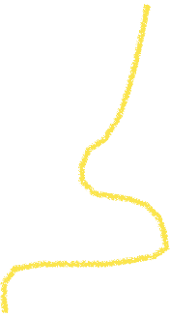
Separation by a complex model
(- =decision boundary)
Feature 2
Feature 1

Slide 44
In classification…
The complexity of a model is the flexibility of the decision boundary (could be a polynomial or something else)
stiff
very elastic
§
increasing complexity

Slide 45
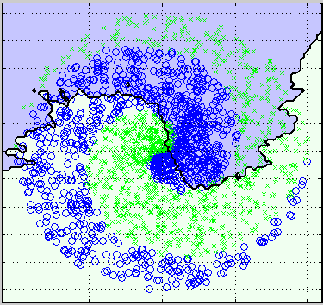
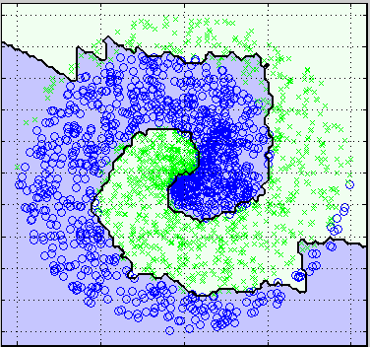
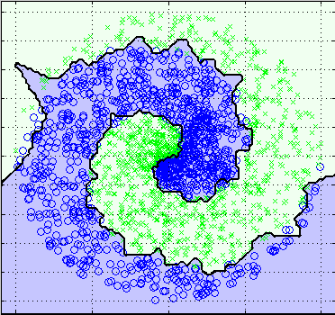
k = 100
k = 10
k = 1
Increasing model complexity

Slide 46
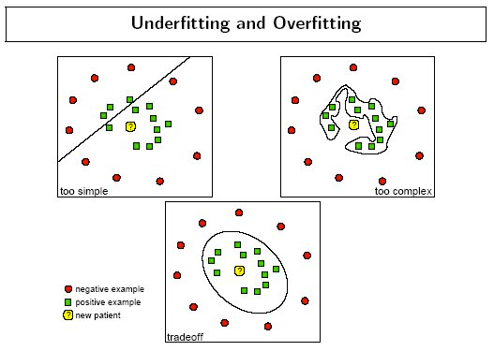

Slide 47
How to determine model complexity?
Depends on complexity of the separation between the classes
Start with the simplest model (large k in kNN), and increase complexity (smaller k) or vice versa
The simplest model is always preferred! Why?

Slide 48
Required Reading
WEKA book:
Chapter 4, Section 4.7 Instance-based learning
Chapter 5, Intro + Sections 5.1 - 5.4 (training & testing, cross validation)
Chapter 6, Intro + Sections 6.1 and 6.5
(decision trees and instance based learning)

